Slide 1
Data Objects
Data sets are made up of data objects.
A data object represents an entity.
Examples:
  sales database: customers, store items, sales
  medical database: patients, treatments
  university database: students, professors, courses
Also called samples , examples, instances, data points, objects, tuples.
Data objects are described by attributes.
Database rows -> data objects; columns ->attributes.

Slide 2
Attributes
Attribute (or dimensions, features, variables): a data field, representing a characteristic or feature of a data object.
  E.g., customer _ID, name, address
Types:
  Nominal
  Binary
  Numeric: quantitative
    Interval-scaled
    Ratio-scaled

Slide 3
Attribute Types
Nominal:
  Relating to names
  Values of nominal attributes are symbol or name of things
  Each value represents some kind of category, or state=>categorical
  In CS, it is also known as enumeration
  Hair_color = {auburn, black, blond, brown, grey, red, white}
  marital status, occupation, ID numbers, zip code
  We can also represent it with numbers- intention is not to use quantitatively
  It does not have any meaning full order

Slide 4
Attribute Types
Binary
  Nominal attribute with only 2 states (0 and 1)
    0 typically means the attribute is absent and 1 meansthe attribute is present.
    It is also called Boolean if two states correspond to true and false
  Symmetric binary: both outcomes equally important
    e.g., gender
  Asymmetric binary: outcomes not equally important.
    e.g., medical test (positive vs. negative)
    Convention: assign 1 to most important outcome (e.g., HIV positive)

Slide 5
Attribute Types
Ordinal
  Values have a meaningful order (ranking) but magnitude between successive values is not known.
  Size = {small, medium, large}, grades, army rankings
  Useful for registering subjective assessments of qualities that cannot be measured objectively
  Used survey for ratings
  Customer satisfaction had the following ordinal categories: 0:Very dissatisfied, 1:somewhat dissatisfied, 2:neutral, 3:satisfied, and 4: very satisfied
  Nominal, binary and ordinal attributes are qualitative.
  Describe the feature of an object without giving an actual size

Slide 6
Attribute Types
Numeric Attributes:
  Quantitative
  Two types- Interval scaled, Ratio scaled
Interval scaled: on a scale of equal size units
  The value of interval scaled attributes have order and can be +ve, 0 or –ve.
  In addition to providing a ranking of values, such attributes allow us to compare and quantify the difference between values.
  Example-temperature attribute
    We have the outdoor temperature value of different days, where each day is an object.
    By ordering the temperature we obtain a ranking of the object
    We can also quantify and compare between different values
  Temperature in Celsius and Fahrenheit do not have a true-zero point
  We can compute the difference but we cann’t say that one temperature value is multiple of another value.

Slide 7
Attribute Types
Ratio scaled: Numeric attributes with inherent zero-point
    A value of being multiple of another value
    The values are ordered and we can also compare the difference between values as well as the mean, median and mode
    Temperature in kelvin, year of experience

Slide 8
Discrete vs. Continuous Attributes
Discrete Attribute
  Has only a finite or countably infinite set of values
    E.g., zip codes, profession, or the set of words in a collection of documents
  Sometimes, represented as integer variables
  Note: Binary attributes are a special case of discrete attributes
  Countably infinite-like age
Continuous Attribute
  Has real numbers as attribute values
    E.g., temperature, height, or weight
  Practically, real values can only be measured and represented using a finite number of digits
  Continuous attributes are typically represented as floating-point variables

Slide 9
Chapter 2: Getting to Know Your Data
Data Objects and Attribute Types
Basic Statistical Descriptions of Data
Data Visualization
Measuring Data Similarity and Dissimilarity
Summary

Slide 10
Basic Statistical Descriptions of Data
Motivation
  To better understand the data: central tendency, variation and spread
Data dispersion characteristics
  median, max, min, quantiles, outliers, variance, etc.
Numerical dimensions correspond to sorted intervals
  Data dispersion: analyzed with multiple granularities of precision
  Boxplot or quantile analysis on sorted intervals
Dispersion analysis on computed measures
  Folding measures into numerical dimensions
  Boxplot or quantile analysis on the transformed cube

Slide 11
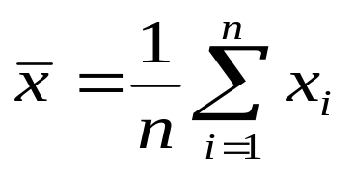


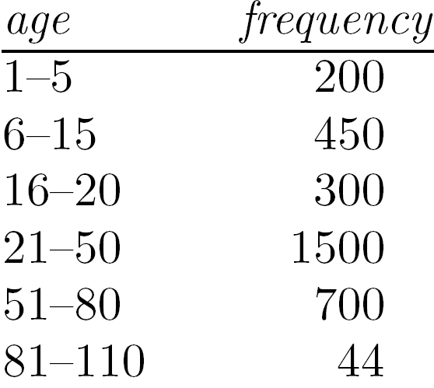
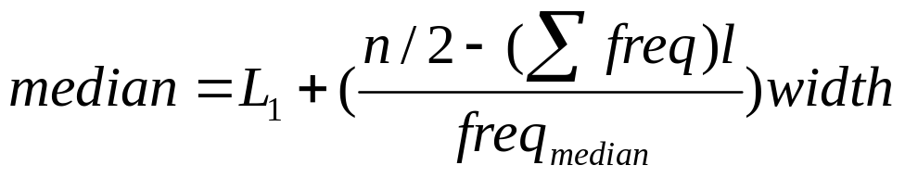
Measuring the Central Tendency
Mean (algebraic measure) (sample vs. population):
  Note: n is sample size and N is population size.
  Weighted arithmetic mean:
  Trimmed mean: chopping extreme values
Median:
  Middle value if odd number of values, or average of the middle two values otherwise
  Estimated by interpolation (for grouped data):
Mode
  Value that occurs most frequently in the data
  Unimodal, bimodal, trimodal
  Empirical formula:

Slide 12

Symmetric
Example
40, 50, 60, 70, 80
Mean = 60
Median = 60
Mode = none (or evenly balanced)
Explanation:
The left and right sides of the data are balanced

Slide 13

Positively Skewed
Example
200, 300, 350, 400, 450, 1200
Mean > Median > Mode
Explanation:
Most people earn lower incomes, but a few earn very high incomes, pulling the mean to the right.

Slide 14

Negatively Skewed
Example
95, 90, 88, 85, 60
Mean < Median < Mode
Explanation:
Most students scored high, but a few low scores pull the mean to the left.

Slide 15
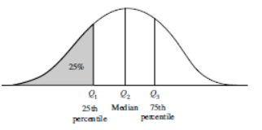
Measuring the Dispersion of Data
Range: The range of a set is the difference between the largest and the smallest values.
Suppose that the data for attribute X are sorted in increasing numeric order. Imagine that we can pick certain data points so as to split the data distribution into equal-size consecutive sets, as in Figure 2.2. These data points are called quantiles.

Slide 16
Measuring the Dispersion of Data
Quantiles are points taken at regular intervals of a data distribution, dividing it into essentially equalsize consecutive sets.
(We say “essentially” because there may not be data values of X that divide the data into exactly equal-sized subsets.
For readability, we will refer to them as equal.) The kth q-quantile for a given data distribution is the value x such that at most k/q of the data values are less than x and at most (q-k)/q of the data values are more than x, where k is an integer such that 0 < k < q. There are q-1 q-quantiles.

Slide 17
Measuring the Dispersion of Data
The 4-quantiles are the three data points that split the data distribution into four equal parts;
100 quantiles are more commonly referred as percentiles
The median, quartiles and percentiles are the most widely used form of quantiles.
The quartiles give an indication of a distribution’s center, spread and shape
Q₁=lowest 25%, Q₂=50th percentile, median= center of data distribution
Q₃=75% ( lowest 75% or highest 25%)

Slide 18
Measuring the Dispersion of Data
The distance between the first and third quartiles is a simple measure of spread that gives the range covered by the middle half of the data. This distance is called the interquartile range (IQR)
Five number summary is the Minimum, Q1, Median, Q3, Maximum

Slide 19
Measuring the Dispersion of Data
Boxplots are a popular way of visualizing a distribution. A boxplot incorporates the five-number summary as follows:
Typically, the ends of the box are at the quartiles so that the box length is the interquartile range.
The median is marked by a line within the box.
Two lines (called whiskers) outside the box extend to the smallest (Minimum) and largest (Maximum) observations.

Slide 20
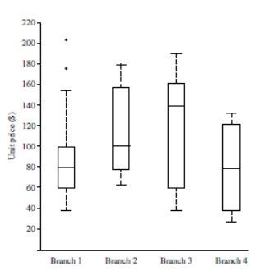
Measuring the Dispersion of Data

Slide 21
Major Tasks in Data Preprocessing
Data cleaning
  Fill in missing values, smooth noisy data, identify or remove outliers, and resolve inconsistencies
Data integration
  Integration of multiple databases, data cubes, or files
Data reduction
  Dimensionality reduction
  Numerosity reduction
  Data compression
Data transformation and data discretization
  Normalization
  Concept hierarchy generation

Slide 22
Data Cleaning
Data in the Real World Is Dirty: Lots of potentially incorrect data, e.g., instrument faulty, human or computer error, transmission error
  incomplete: lacking attribute values, lacking certain attributes of interest, or containing only aggregate data
    e.g., Occupation=“ ” (missing data)
  noisy: containing noise, errors, or outliers
    e.g., Salary=“−10” (an error)
  inconsistent: containing discrepancies in codes or names, e.g.,
    Age=“42”, Birthday=“03/07/2010”
    Was rating “1, 2, 3”, now rating “A, B, C”
    discrepancy between duplicate records
  Intentional (e.g., disguised missing data)
    Jan. 1 as everyone’s birthday?

Slide 23
Data Cleaning as a Process
Data discrepancy detection
  Use metadata (e.g., domain, range, dependency, distribution)
  Check field overloading
  Check uniqueness rule, consecutive rule and null rule
  Use commercial tools
    Data scrubbing: use simple domain knowledge (e.g., postal code, spell-check) to detect errors and make corrections
    Data auditing: by analyzing data to discover rules and relationship to detect violators (e.g., correlation and clustering to find outliers)
Data migration and integration
  Data migration tools: allow transformations to be specified
  ETL (Extraction/Transformation/Loading) tools: allow users to specify transformations through a graphical user interface
Integration of the two processes
  Iterative and interactive (e.g., Potter’s Wheels)

Slide 24
Data Integration
Data integration:
  Combines data from multiple sources into a coherent store
Schema integration: e.g., A.cust-id ≡ B.cust-#
  Integrate metadata from different sources
Entity identification problem:
  Identify real world entities from multiple data sources, e.g., Bill Clinton = William Clinton
Detecting and resolving data value conflicts
  For the same real world entity, attribute values from different sources are different
  Possible reasons: different representations, different scales, e.g., metric vs. British units

Slide 25
Data Reduction Strategies
Data reduction: Obtain a reduced representation of the data set that is much smaller in volume but yet produces the same (or almost the same) analytical results
Why data reduction? — A database/data warehouse may store terabytes of data. Complex data analysis may take a very long time to run on the complete data set.
Data reduction strategies
  Dimensionality reduction, e.g., remove unimportant attributes
    Wavelet transforms
    Principal Components Analysis (PCA)
    Feature subset selection, feature creation
  Numerosity reduction (some simply call it: Data Reduction)
    Regression and Log-Linear Models
    Histograms, clustering, sampling
    Data cube aggregation
  Data compression

Slide 26
Data Transformation
A function that maps the entire set of values of a given attribute to a new set of replacement values s.t. each old value can be identified with one of the new values
Methods
  Smoothing: Remove noise from data
  Attribute/feature construction
    New attributes constructed from the given ones
  Aggregation: Summarization, data cube construction
  Normalization: Scaled to fall within a smaller, specified range
    min-max normalization
    z-score normalization
    normalization by decimal scaling
  Discretization: Concept hierarchy climbing

Slide 27
Discretization
Three types of attributes
  Nominal—values from an unordered set, e.g., color, profession
  Ordinal—values from an ordered set, e.g., military or academic rank
  Numeric—real numbers, e.g., integer or real numbers
Discretization: Divide the range of a continuous attribute into intervals
  Interval labels can then be used to replace actual data values
  Reduce data size by discretization
  Supervised vs. unsupervised
  Split (top-down) vs. merge (bottom-up)
  Discretization can be performed recursively on an attribute
  Prepare for further analysis, e.g., classification

Slide 28
Data Visualization
Why data visualization?
  Gain insight into an information space by mapping data onto graphical primitives
  Provide qualitative overview of large data sets
  Search for patterns, trends, structure, irregularities, relationships among data
  Help find interesting regions and suitable parameters for further quantitative analysis
  Provide a visual proof of computer representations derived
Categorization of visualization methods:
  Pixel-oriented visualization techniques
  Geometric projection visualization techniques
  Icon-based visualization techniques
  Hierarchical visualization techniques
  Visualizing complex data and relations

Slide 29
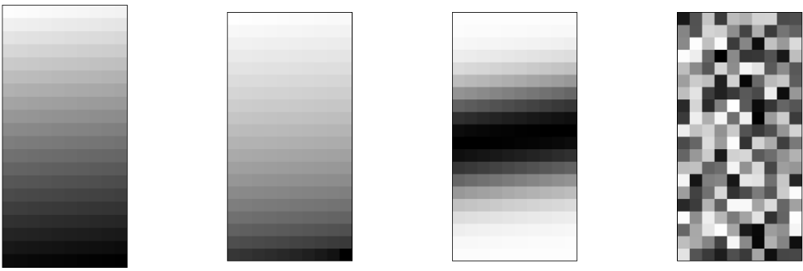
Pixel-Oriented Visualization Techniques
For a data set of m dimensions, create m windows on the screen, one for each dimension
The m dimension values of a record are mapped to m pixels at the corresponding positions in the windows
The colors of the pixels reflect the corresponding values
Income
(b) Credit Limit
(c) transaction volume
(d) age

Slide 30
Geometric Projection Visualization Techniques
Visualization of geometric transformations and projections of the data
Methods
  Direct visualization
  Scatterplot and scatterplot matrices
  Landscapes
  Projection pursuit technique: Help users find meaningful projections of multidimensional data
  Prosection views
  Hyperslice
  Parallel coordinates

Slide 31
Icon-Based Visualization Techniques
Visualization of the data values as features of icons
Typical visualization methods
  Chernoff Faces
  Stick Figures
General techniques
  Shape coding: Use shape to represent certain information encoding
  Color icons: Use color icons to encode more information
  Tile bars: Use small icons to represent the relevant feature vectors in document retrieval

Slide 32
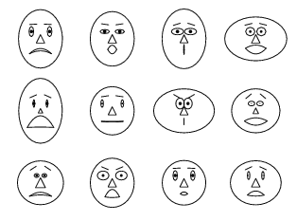
Chernoff Faces
A way to display variables on a two-dimensional surface, e.g., let x be eyebrow slant, y be eye size, z be nose length, etc.
The figure shows faces produced using 10 characteristics--head eccentricity, eye size, eye spacing, eye eccentricity, pupil size, eyebrow slant, nose size, mouth shape, mouth size, and mouth opening): Each assigned one of 10 possible values, generated using Mathematica (S. Dickson)
REFERENCE: Gonick, L. and Smith, W. The Cartoon Guide to Statistics. New York: Harper Perennial, p. 212, 1993
Weisstein, Eric W. "Chernoff Face." From MathWorld--A Wolfram Web Resource. mathworld.wolfram.com/ChernoffFace.html

Slide 33
Hierarchical Visualization Techniques
Visualization of the data using a hierarchical partitioning into subspaces
Methods
  Dimensional Stacking
  Worlds-within-Worlds
  Tree-Map
  Cone Trees
  InfoCube

Slide 34
Similarity and Dissimilarity
Similarity
  Numerical measure of how alike two data objects are
  Value is higher when objects are more alike
  Often falls in the range [0,1]
Dissimilarity (e.g., distance)
  Numerical measure of how different two data objects are
  Lower when objects are more alike
  Minimum dissimilarity is often 0
  Upper limit varies
Proximity refers to a similarity or dissimilarity

